Slide 1
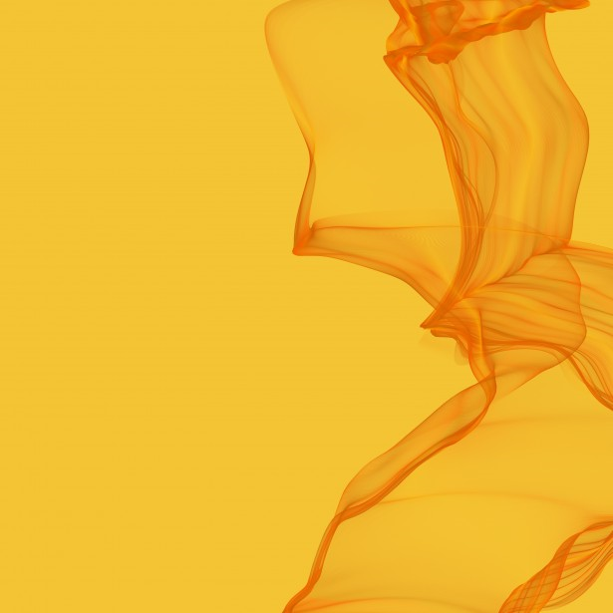
I am a pure Orange
I’m a orange.

Slide 2
I am a orange because…
I love to have fun and if I am not having negative attitude I get super bored except for school.
I have a very creative mind and I also have a really big imagination.
I do not get along with gold that much but I can if I try.
I get irritated with people who are saying weird things and if they are physically harming

Slide 3
I love being an orange because…
I’m creative because I normally come up with these amazing ideas which my fifth grade class teacher liked.
If we were having a conversation I got indulged in that conversation and I also asked a lot of questions about the subject.
I am very adventurous because I will try almost any food I see even if it looks really disgusting.
I am a person who is a big fan of fun I love having fun inside and outside, inside: I love monopoly pay day and many more board games, outside: I love being in my pool and I also like being in nature, and I also live going on my trampoline and I also pretend play to.
That is why I am an orange!!!

Slide 4
A friend of mine named Alex is very orange because…
He is a giant risk taker he almost will never turn down a dare he jumped of my balcony in to the trampoline too.
He loves having fun like me.

Slide 5
Gold
Being a gold means that you are very organized and neat.
It also means that you call people out if they are cheating even if you are just messing around.
If you walked into their bedroom it would be very clean neat and organized.
Being a gold also means that you set high standards for yourself too.
And you will like structure too.

Slide 6
Green
If you are a green you don’t have structure that much.
I work best independently without a partner.
You are calm and nice.

Slide 7
Being an orange means…
You are extremely creative.
You are extremely adventures.
Your adventures.
And many more things.

Slide 8
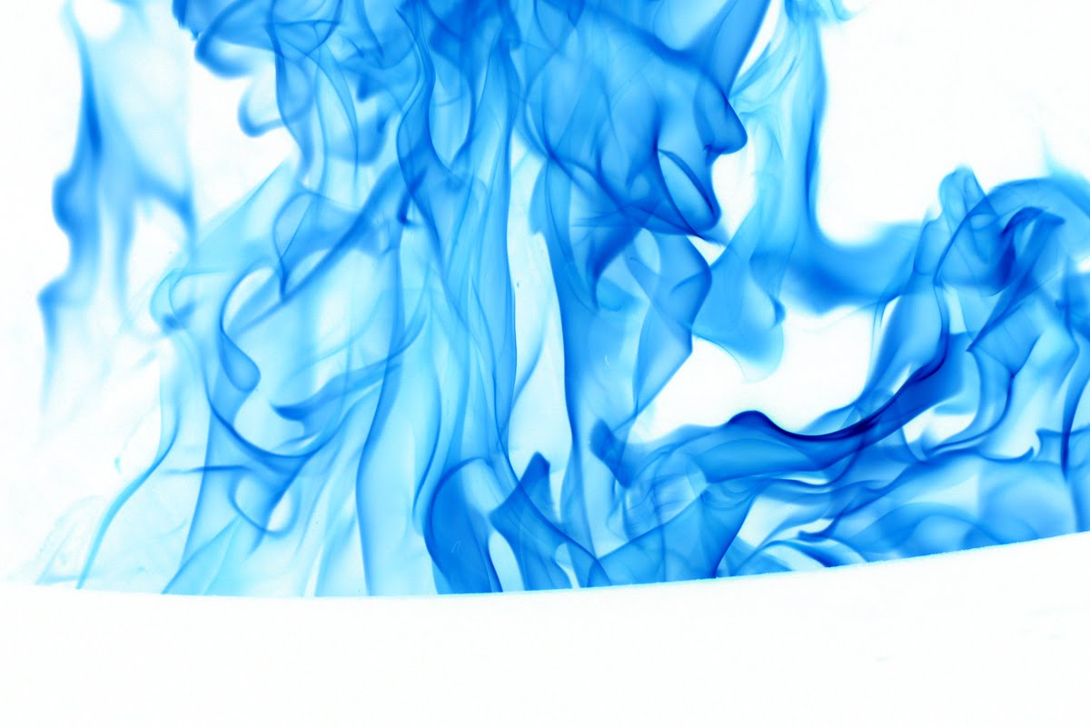
Blue
If you are a blue it means that you are sensitive.
You prefer harmony over violence
You let go of stuff very easily.
And you are extremely nice and social.

Slide 9
Thank you for listening to my true colors

